Slide 1

Opening a New Japanese Restaurant in Ann Arbor, Michigan
Tom Tian
November 2019

Slide 2
Introduction
The objective of this capstone project is to analyze and select the best locations in the city of Ann Arbor, Michigan to open a new Japanese restaurant.
Try to detect locations that are not already crowded with Japanese restaurants or with no Japanese restaurants at all.

Slide 3
Data
The number of existing Asian restaurants in Ann Arbor, Michigan.
The number of Japanese restaurants in the city.
Latitude and longitude coordinates of the neighborhoods. This is required in order to plot the map and to get the venue data.
Venue data, particularly data related to restaurants. We will use this data to perform clustering on the neighborhoods.

Slide 4
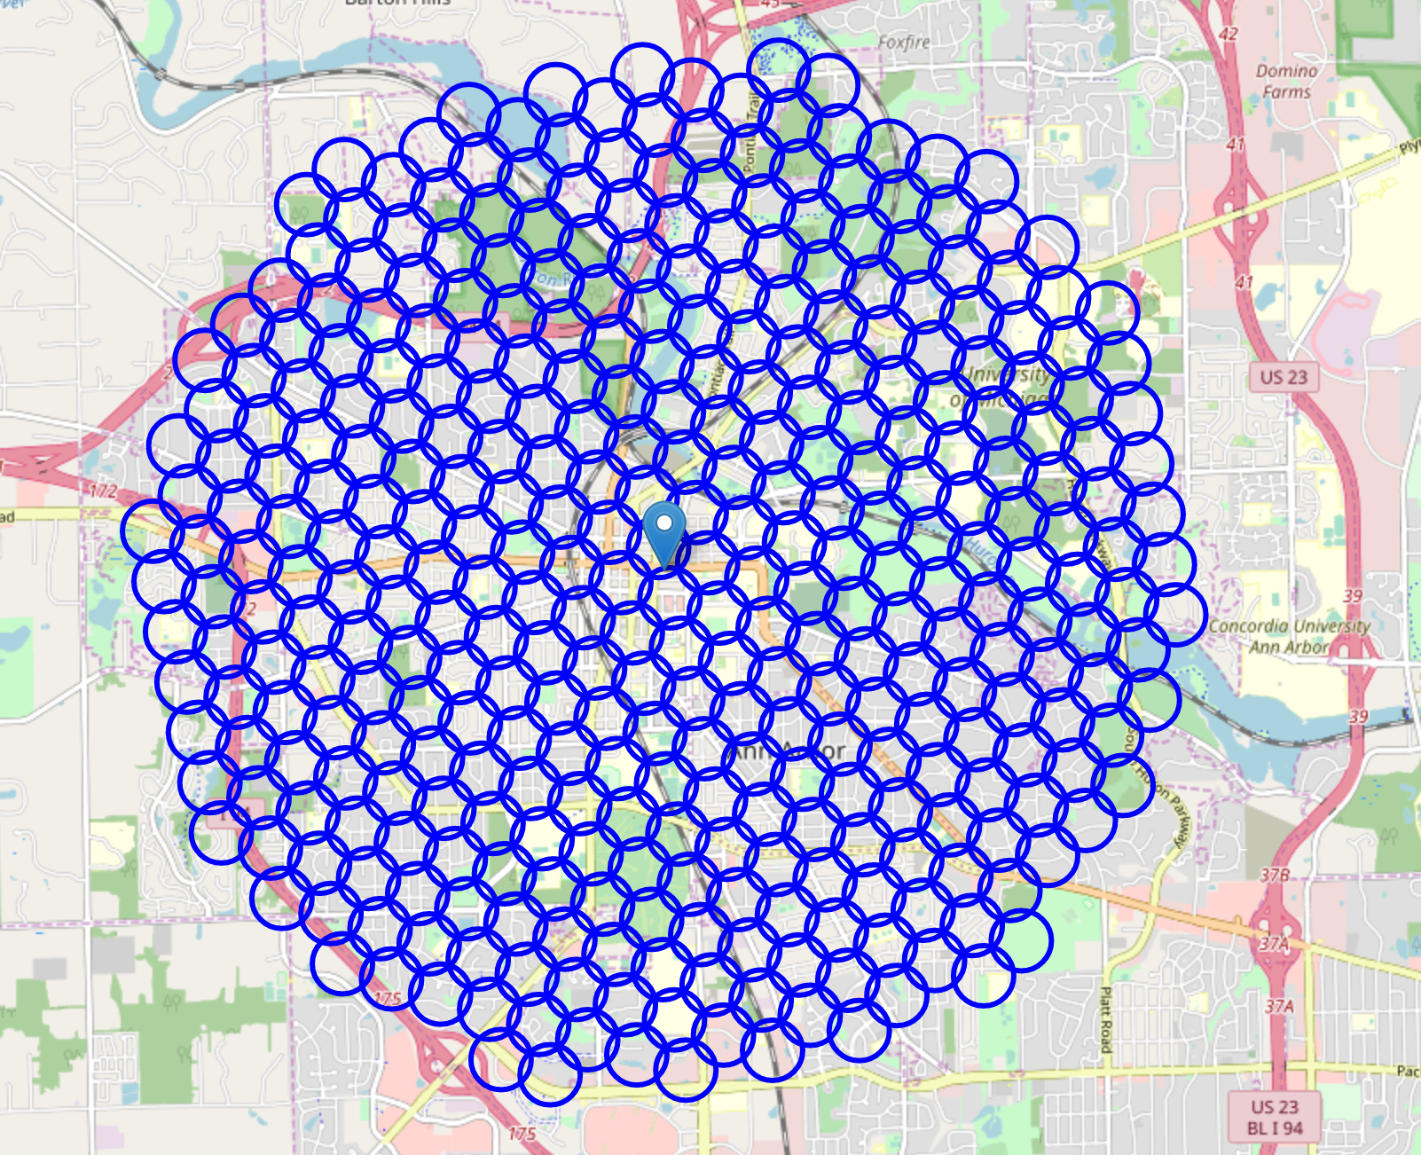
Google Maps API reverse geocoding

Slide 5
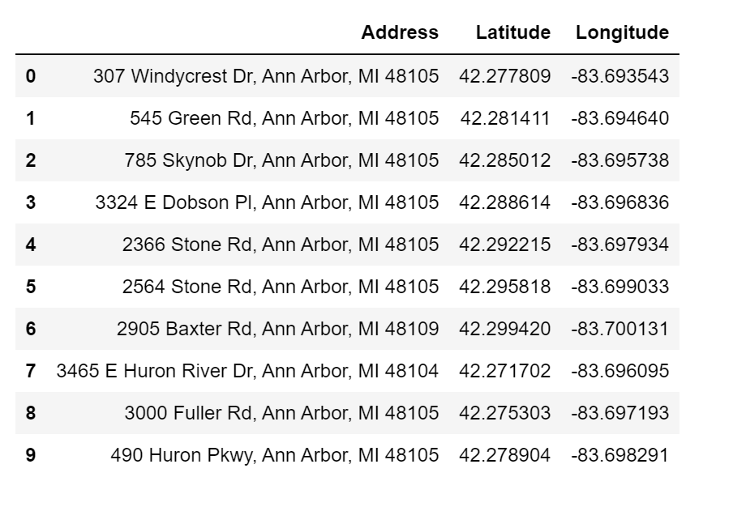
the venue data from Foursquare API

Slide 6
Methodology
Use the Google Map API to decide the latitude and longitude of the city center. After gathering the data, we will populate the data into a pandas Data Frame and then visualize the neighborhoods in a map using Folium package.
Use Foursquare API to get all the Asian restaurants and Japanese restaurants within a radius of 6000 meters of the city center based on the Foursquare categories.
Perform clustering on the data by using k-means clustering.
We will cluster the neighborhoods into 4 clusters based on their frequency of occurrence for Asian Restaurants.
The results will allow us to identify which neighborhoods have higher concentration of Japanese restaurants..

Slide 7
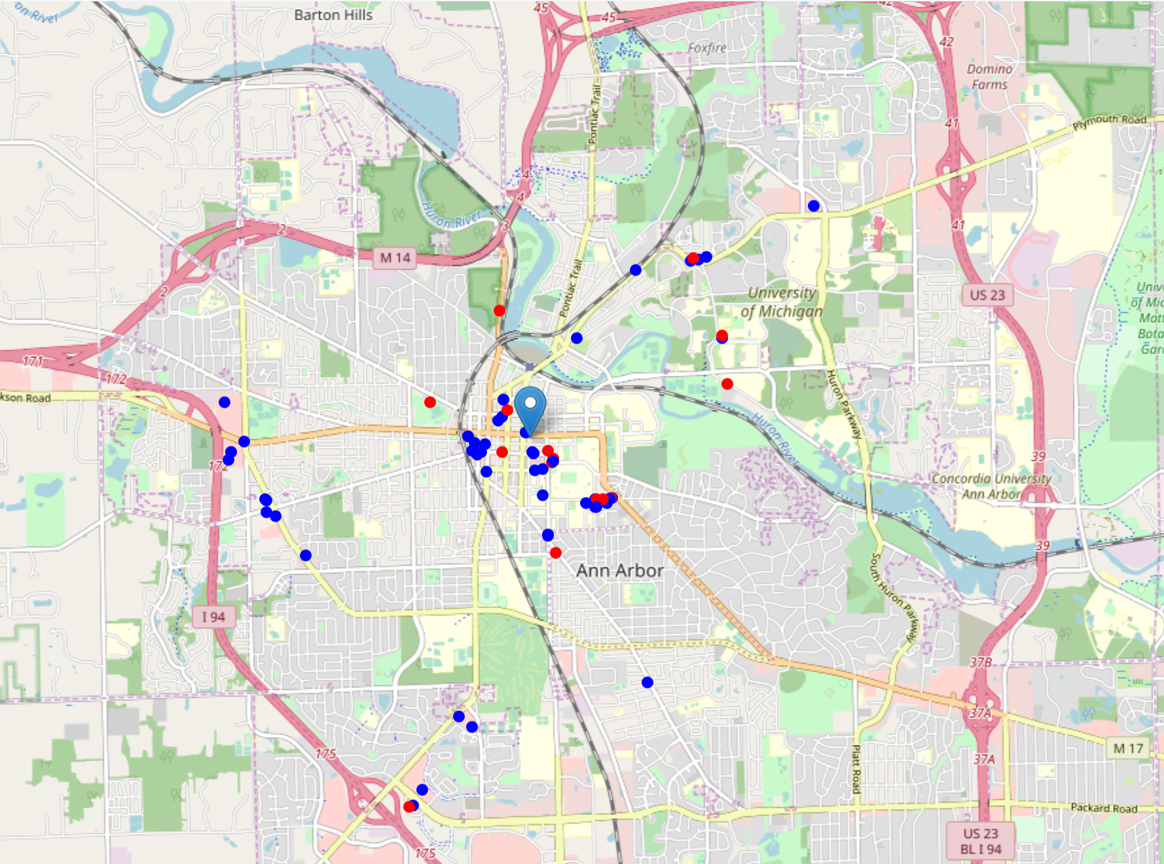
Methodology

Slide 8
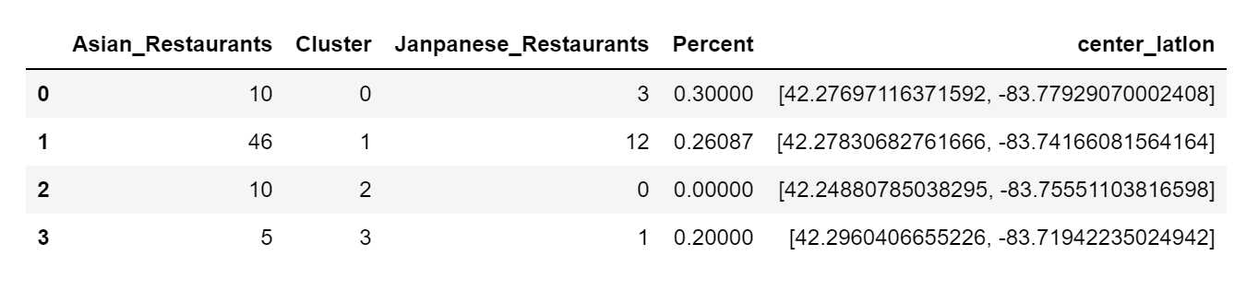
Results
The results from the k-means clustering show that we can categorize the neighborhoods into 4 clusters based on the frequency of occurrence for Asian restaurants.
It shows that the west campus of the city has the lowest density of Japanese restaurants.

Slide 9
Discussion
From the results of the clustering are visualized in the map, most of the Asian restaurants are concentrated in the central area of the city of Ann Arbor.
Around 20% - 30% of the restaurants in the central area, north suburb, and south suburb are Japanese restaurants among all the Asian restaurants in each area.
The west suburb in the neighborhoods have 10 Asian restaurants but has no Japanese restaurant, which represents a great opportunity and a high potential area to open new Japanese restaurants as there is very little to no competition from existing business.

Slide 10
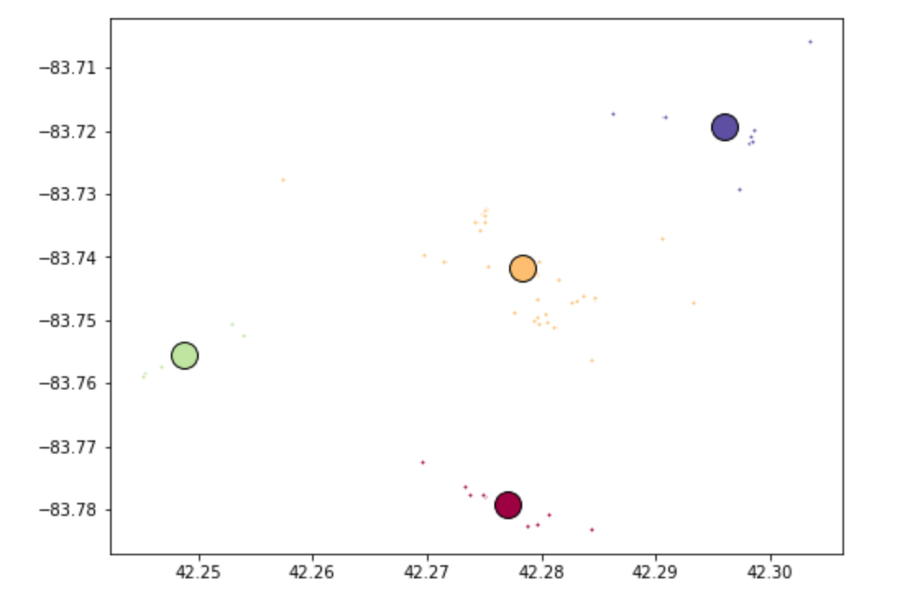
Clustering

Slide 11
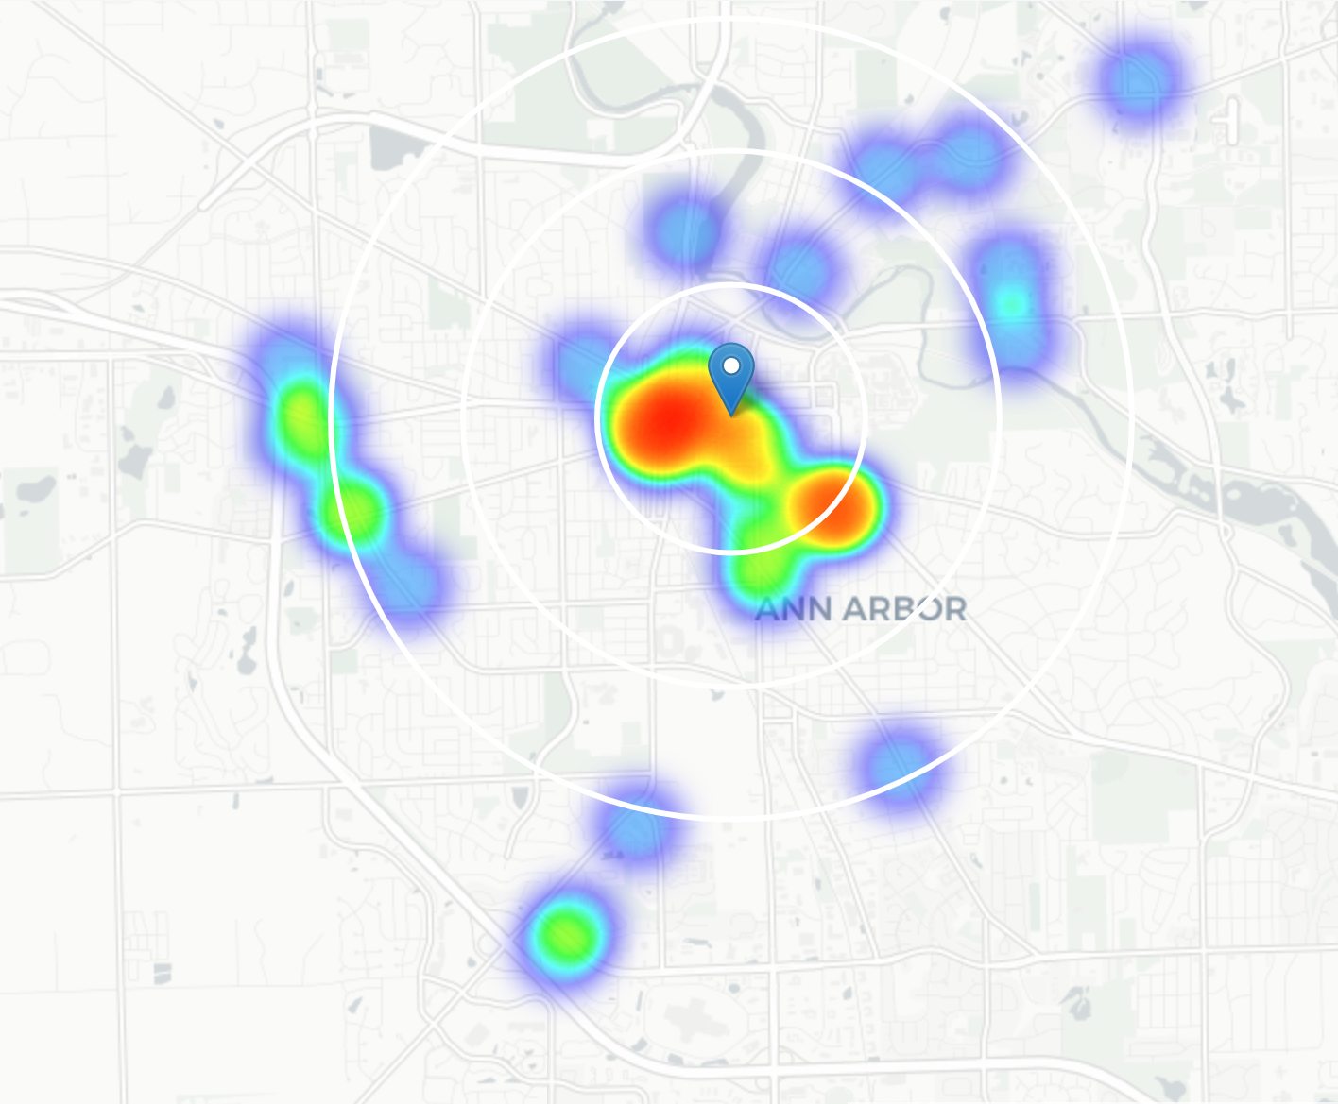
Heatmap based on the density of Japanese restaurants

Slide 12
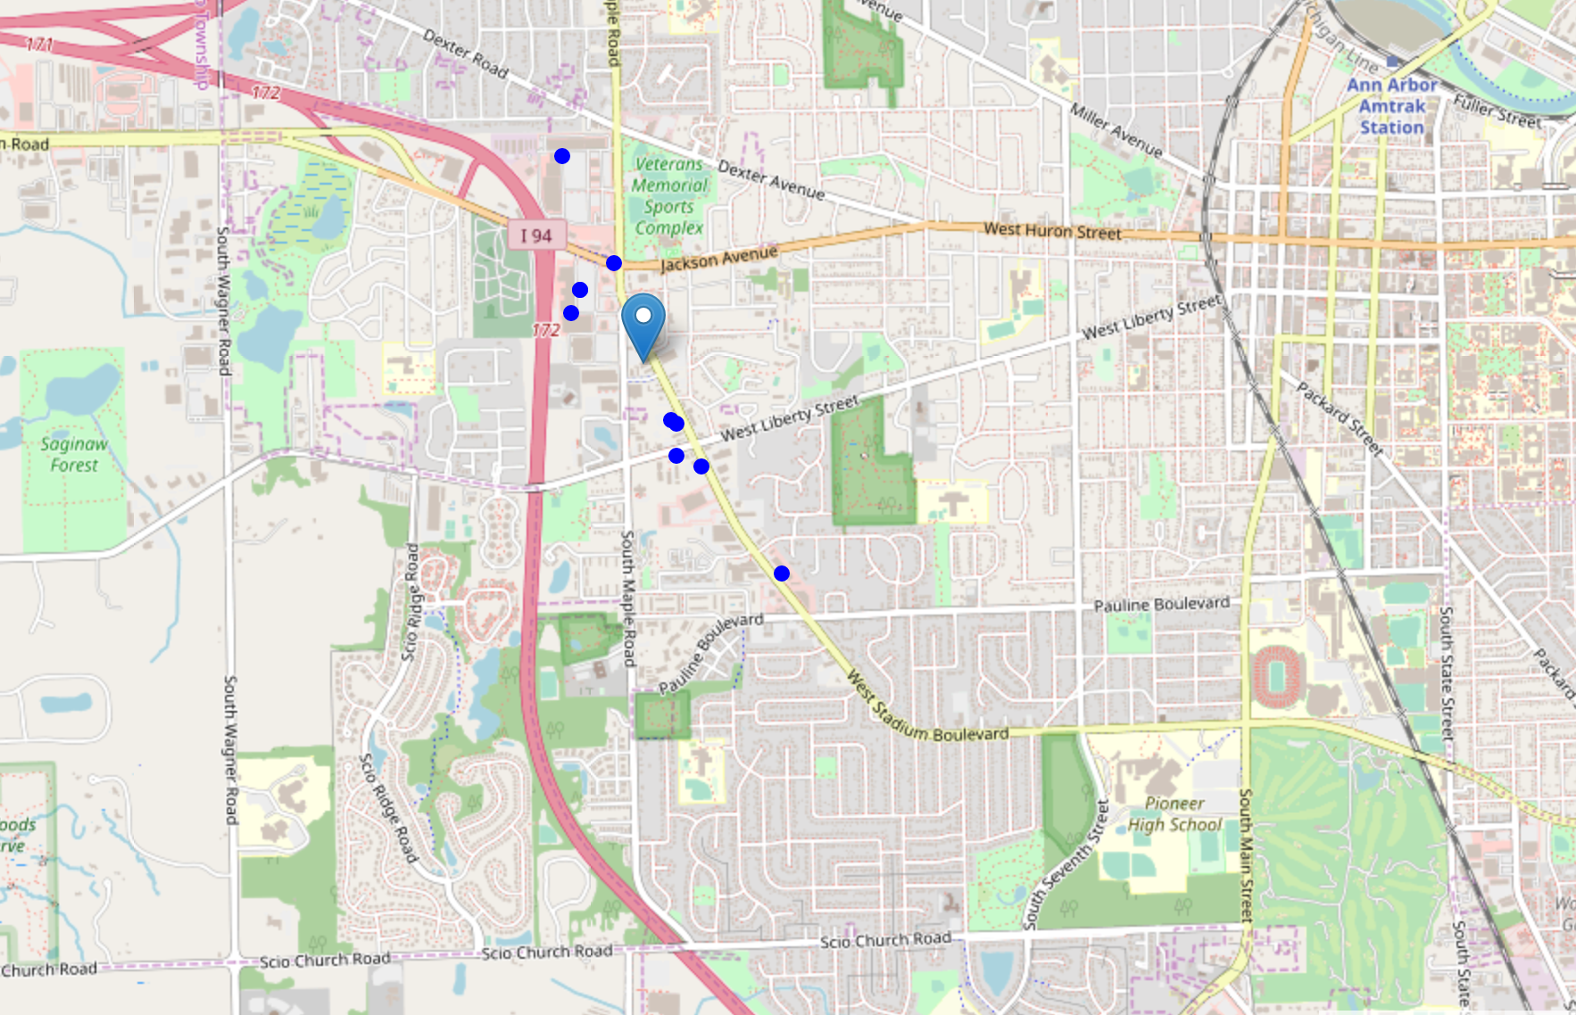
Recommended area

Slide 13
Conclusion
In this project, we have gone through the process of identifying the business problem, specifying the data required, preparing and cleaning the data, performing machine learning by clustering the data into 4 clusters based on their similarities, and lastly providing recommendations to the relevant investors regarding the best locations to open a new Japanese restaurant.
The neighborhood in the west suburb of Ann Arbor is the most preferred location to open a new Japanese restaurant.
The findings of this project will help the relevant stakeholders to capitalize on the opportunities on high potential locations while avoiding overcrowded areas in their decisions to open a new Japanese restaurant.

Slide 14
Limitations
In this project, we only consider one factor i.e. frequency of occurrence of Japanese restaurants, there are other factors such as Japanese population and income of residents that could influence the location decision of a new Japanese restaurant.
Future research could devise a methodology to estimate such data to be used in the clustering algorithm to determine the preferred locations to open a new Japanese restaurant.
In addition, this project made use of the free individual account of Foursquare API that came with limitations as to the number of API calls and results returned.

